Slide 1
Introduction to F#
or: How I Learned to Stop Worrying and Love the Func

Slide 2
What is F#
Functional first language on the CLR
Open-sourced with Microsoft support
Immutable by default; mutable by choice
Heavily type-inferred
Very succinct and extremely expressive
High signal to noise ratio
Very active community with cool projects:
UI Webtesting
F# to GPGPU
F# to JavaScript compiler
Type providers for:
JSON, SQL, OData, XML, RegEx, CSV, EXCEL, R
Notes:
Functional first = pragmatic approach which allow for both OO and mutability
Heavily type-inferred gives you the ease and beauty of a dynamic language

Slide 3
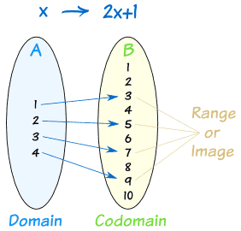
What is functional programming?
Functions like we know them from math
Domain, codomain and range
No side-effects
Notes:
F# is auto-curried

Slide 4
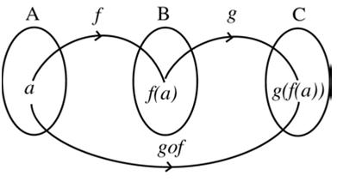
What is functional programming?
Currying and partial function application
Function composition
f ° g = f(g(x)) = f << g
g ° f = g(f(x)) = f >> g
Notes:
F# is auto-curried

Slide 5
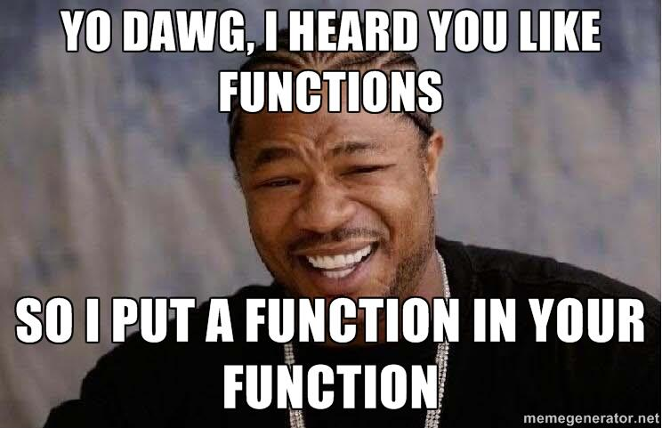
What is functional programming?
Higher-order functions
Functions that take functions
Functions that return functions
Notes:
F# is auto-curried

Slide 6
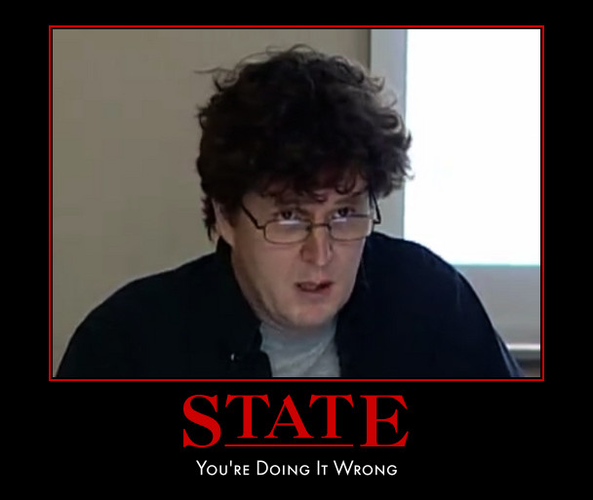
What is functional programming?
Immutability often included in the deal
Value doesn’t change
Identity is a stable logical entity associated with a series of values that changes over time
State is what an identity has
http://www.infoq.com/presentations/Value-Identity-State-Rich-Hickey
Notes:
F# is auto-curried

Slide 7
What functional programming is not
Scary
Harder than Object Oriented programming
In fact the immutability often makes it simpler to reason about your programs behavior
Only for mathmaticians and research computer scientists
A silver bullet

Slide 8
There and back again
F#
Pattern matching
Discriminated Unions
Records
Object expressions
Type providers
Unit of measure
Agents
Options
Choice
Literal tuples
Computation Expressions
Static duck typing
Built-in scriptable
REPL
C#
Partial classes
Multiple same generic interface impl.
NullReferenceException
Tooling

Slide 9


The business case
Time to Market
Effiency
Correctness
Complexity
“The present application contains 35 to 40.000 lines of F#-code and an equal amount of C#-code. However, our estimate is that the F# code contains at least 80% of the functionality (which is pretty amazing!). Our experience shows us that the number of code lines shrinks with a ratio of 1/2 to 1/4 by just porting functionality from C# to F#”
”Experienced F# developers regularly solve problems in days that would take weeks using more traditional languages… solving complex problems in an elegant and highly maintainable matter.”
[…] the one stat in the summary that I find most compelling is the defect rate. I have now delivered three business critical projects written in F#. I am still waiting for the first bug to come in. This is not the case with the C# projects I have delivered. […] It might be that I am just on a lucky streak, but I suspect that the clarity and concision of F# code contributes greatly to its correctness.
Notes:
- Help distinguishing d60 from other consultancies
- Help distinguishing you from other programmers

Slide 10
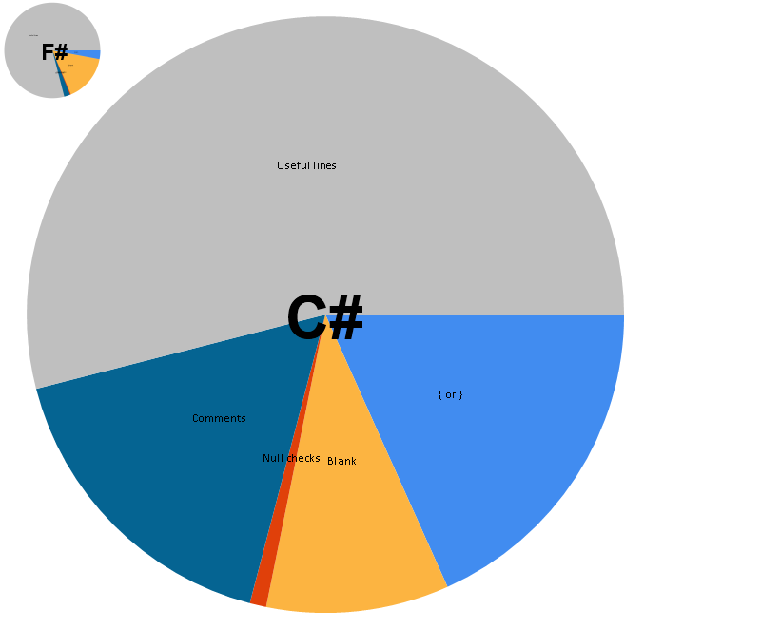
Everyone love stats!
Metric | C# Project | F# Project | The F# Difference
Useful lines | 183856 | 7112 | 26x
Comment lines | 57624 | 182 | 32x
Null check lines | 3036 | 27 | 112x
Blank lines | 33678 | 1416 | 24x
Brace lines | 62282 | 265 | 235x
Team Size | 7 | 2 | 3.5x
Project Duration | 5 years | 4 months | 15x
Defects since go live | too many | zero | tending to infinity

Slide 11
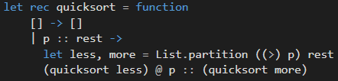
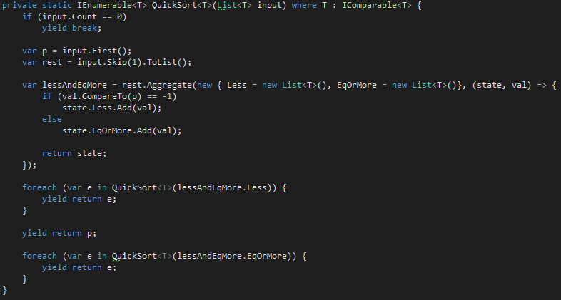
So how succinct is F#

Slide 12
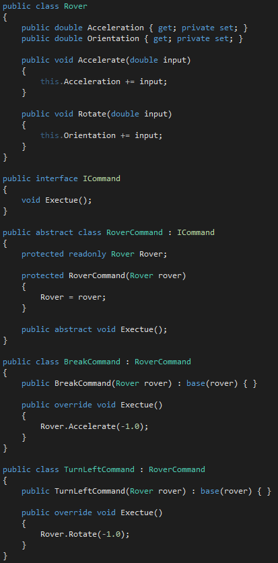
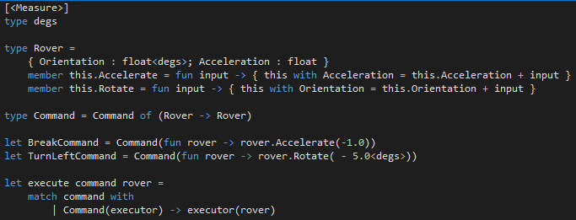
So how succinct is F#

Slide 13
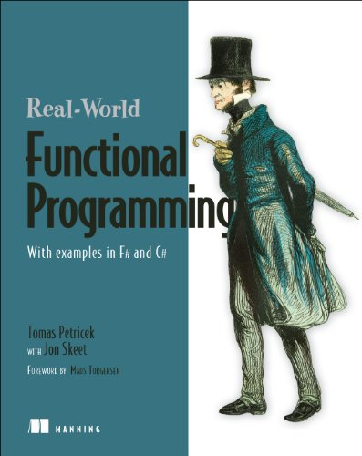
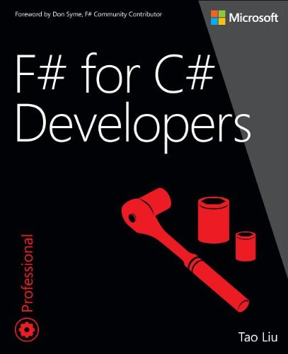
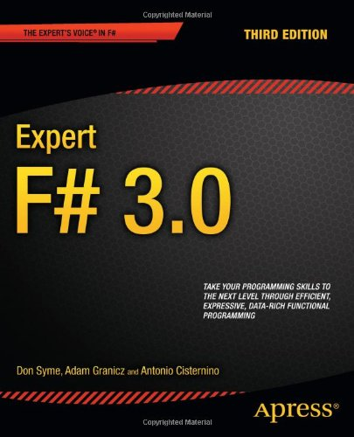

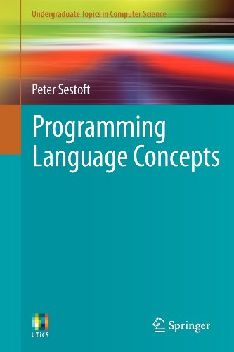
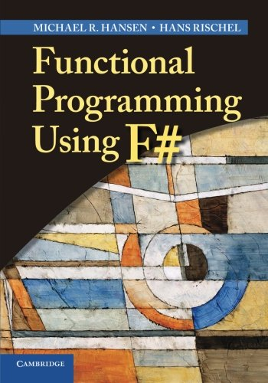
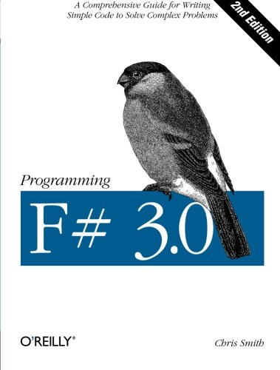
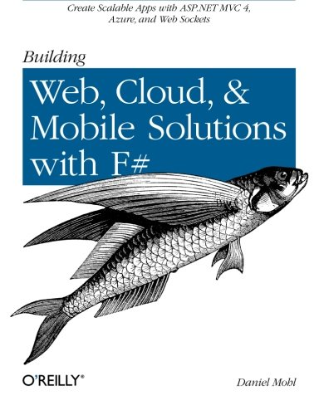
Ressources
fsharpforfunandprofit.com
fsharp.org
tryfsharp.org

